Slide 1
Georgia Women during the Time of Secession
Grace McLaine and Sarah Upton
ESOC 4000
Dr. VanSledright

Slide 2
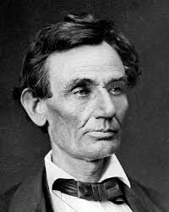
Election of 1860
Abraham Lincoln elected as the 16th President of the United States on November 6, 1860
Southerners concerned about States’ Rights and the issue of slavery
Southern states begin to hold conventions on the issue of secession

Slide 3
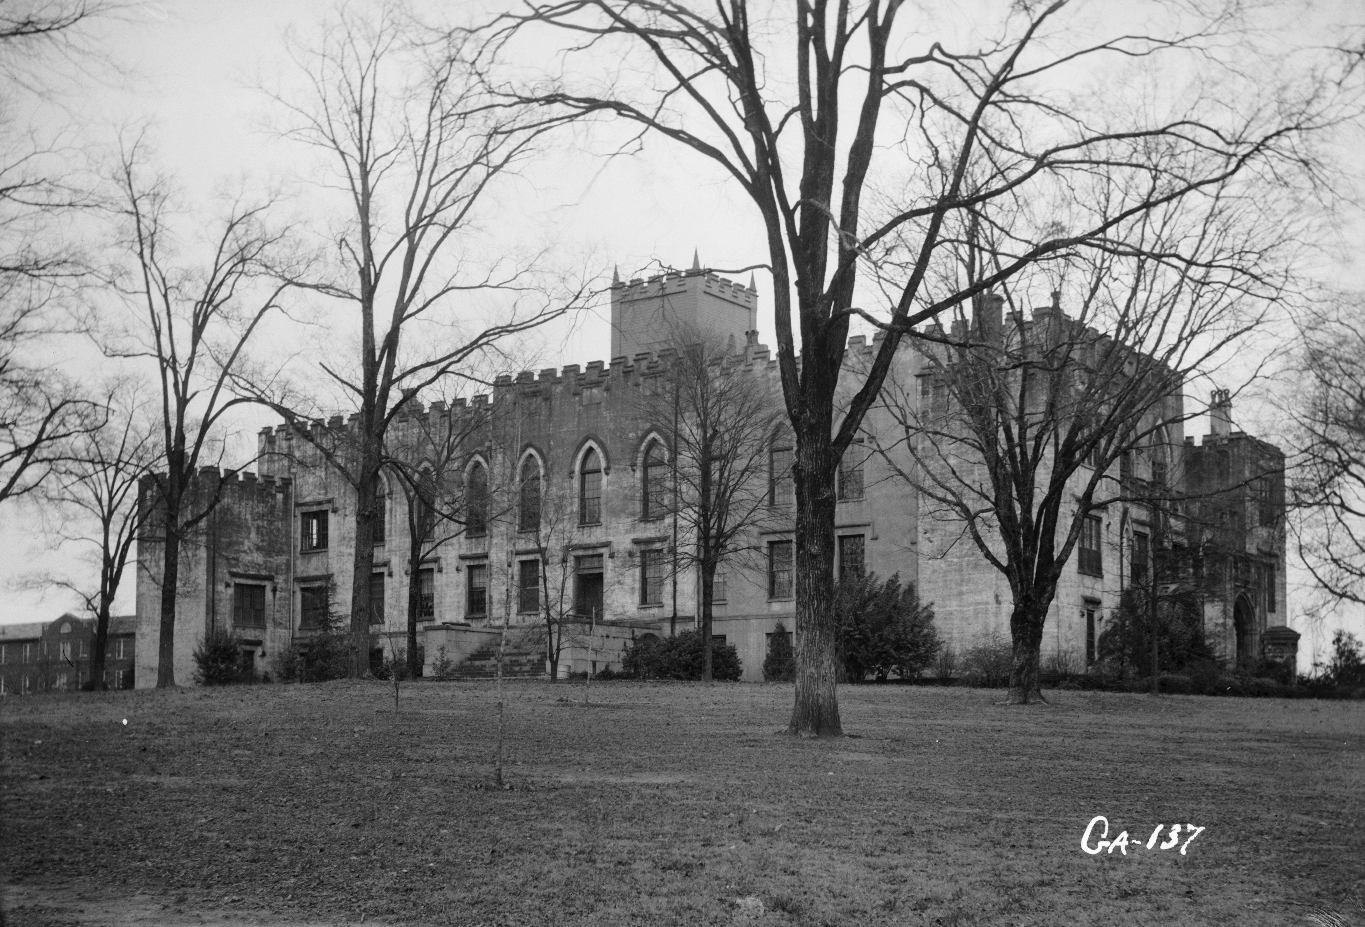
Secession Debate
South Carolina secedes 1st on December 20th, 1860
Georgia holds their convention in January 1861 in Milledgeville
Georgia secedes on January 19th

Slide 4
“Typical” Gender Roles in 19th Century Georgia
Men
Women
Head of Household
“Bread-Winner”
Makes the money for the family
Political decision maker
Disciplinarian
Stay-at-home mom
Supportive spouse
Child Bearer
Making sure house is well-kept

Slide 5
19th Century Women in Georgia
Elite women born into life of luxury
Educated just as well as their male counterparts
Would marry to continue family lineage
Often interested in politics because of their fathers or husbands
Would often resemble political beliefs of their male family members
Question of whether these women had an impact on politics during this time period

Slide 6
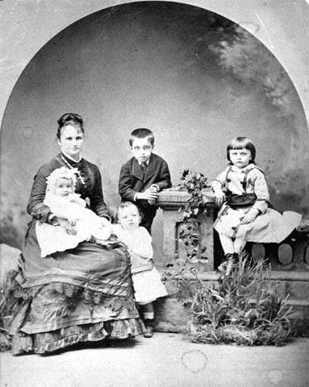
BEFORE THE WAR

Slide 7
DURING THE WAR

Slide 8
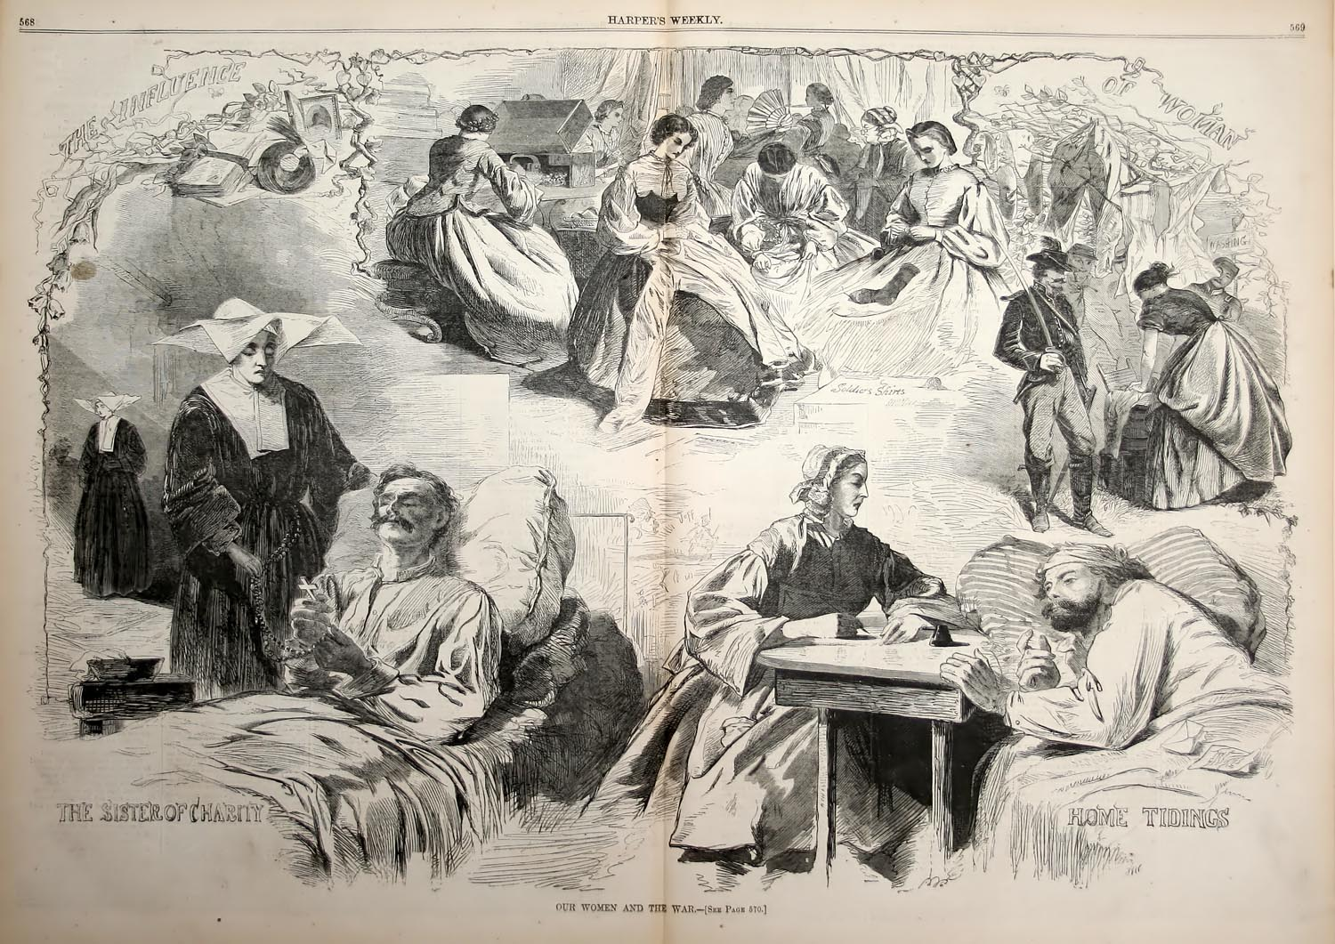

Slide 9
Mary Ann Lamar Cobb
Married to Howell Cobb
Former Governor of Georgia
Secretary of the Treasury under President Buchanan
Had 12 children between the years of 1835 and 1860 however 4 died at infancy. She was extremely devoted to her faith and her family, always encouraging them in her letters.

Slide 10
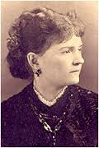
Eliza Frances Andrews
Born August 10, 1840 in Washington, GA.
Very well educated – attended LaGrange Female College
Her father, Garnett Andrews, supported the Union
Eliza supported the secession
The night Georgia’s decision to secede reached her hometown of Washington, Eliza and her sisters sewed together a Bonnie Blue Confederate flag that would eventually be flown outside the courthouse.

Slide 11
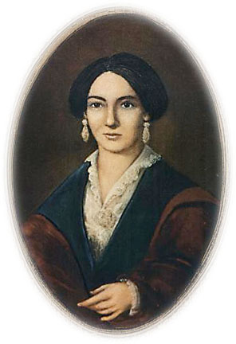
Ella Gertrude Clanton Thomas
Daughter of wealthy Augusta plantation owner, Turner Clanton
Attended Wesleyan Female College
Married James Thomas
Birthed 10 children, 7 survived
Involved in several civic and social organizations
Hayne Circle Literary Society
Woman’s Christian Temperance Union
United Daughters of the Confederacy
Etc…

Slide 12
ACTIVITY
Groups of 6
Read hand outs
Decide whether the woman supported Secession (whether BEFORE or AFTER the Convention)
Meet with your Corresponding Group (1A & 1B / 2A &2B / 3A and 3B)
Discuss the comparisons of BEFORE and AFTER the war

Slide 13
Homework
Write 2 Paragraphs about your findings including:
Their stance BEFORE the war
Their stance AFTER the war
Why they changed / did not change
How did their beliefs / social standing affect their decisions?
How might their decisions be different than Middle or Lower Class women?

Slide 14
Wrap-Up
Mary Ann Lamar Cobb
Eliza Frances Andrews
Ella Gertrude Clanton Thomas

Slide 15
Mary Ann Lamar Cobb
Mary Ann was against the abolitionists and wrote ill of them occasionally
Her excitement about Georgia’s decision to secede is evident in a letter she wrote to her son in which she wrote about the secession and included an abundance of exclamation marks
She cared for the refugees and wrote about her desire to help more.
The loss of the war took its toll on her husband. He felt responsible for the people of Georgia.

Slide 16
Eliza Frances Andrews
Throughout the war she remained loyal to the Confederate side despite her father’s opinions
She never changed her mind about the secession but did regret the manner in which she treated her father.
“Never been able to repent of having sided with my own people. I have repented in sack cloth and ashes for the perverse and rebellious spirit so often manifested against him”

Slide 17
Ella Gertrude Clanton Thomas
Early 1860’s – stout supporter of secession and the Confederacy
Began to grow weary of the war
Realizes that people are not aware of the severity of the war
Pregnancy makes her very frail and weak
Once her father dies, and families finances struggle – she is no longer the stout supporter of the Confederacy that she once was
Husband turning towards alcohol
Financial struggles
Forced to sell most of her property after war because of growing debt

Slide 18
Comparing the Women
Mary Ann Cobb reflects the type of woman who supports her husband in anything and everything they do.
Eliza Frances Andrews reflects the type of woman who stands her ground on her beliefs despite family influences
Ella Gertrude Clanton Thomas reflects the type of woman who realizes the devastating effects the war has on a family – a changing woman

Slide 19
Importance of these Women
Through the eyes of these women, readers are better equipped to understand the daily lives of Antebellum Southerners and how the Civil War completely altered their lifestyles
These women had an impact on local politics, whether directly or indirectly
Mary Ann as Directress of the Ladies Aid Society
Eliza making a Confederate Flag
Ella involved with the Ladies Missionary Society of St. John’s Methodist Church

